Slide 1
Good Morning

Slide 2
Public Lands … the secret is out!

Slide 3
PUBLIC LANDS COMMITTEE (PLC)
Relationships with Land Managers
TIMING IS EVERYTHING!

Slide 4
PUBLIC LANDS COMMITTEE (PLC)
Tools to use for a successful Partnership
with the governing agencies of our public lands
VOLUNTEER AGREEMENTS
CHALLENGE COST SHARE AGREEMENTS

Slide 5
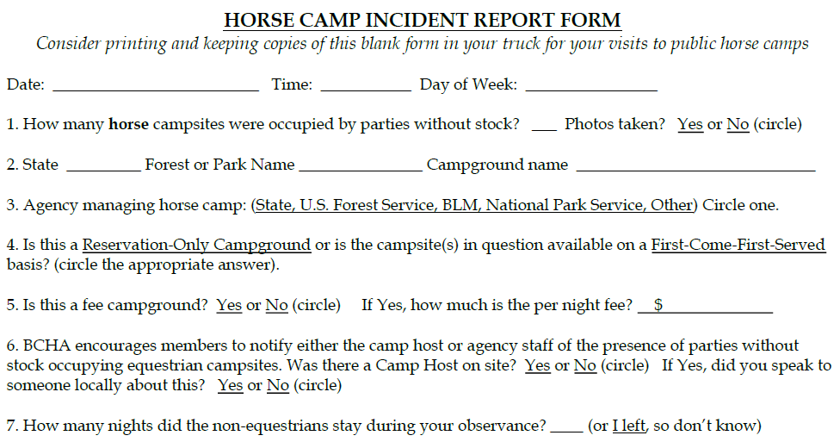

Slide 6
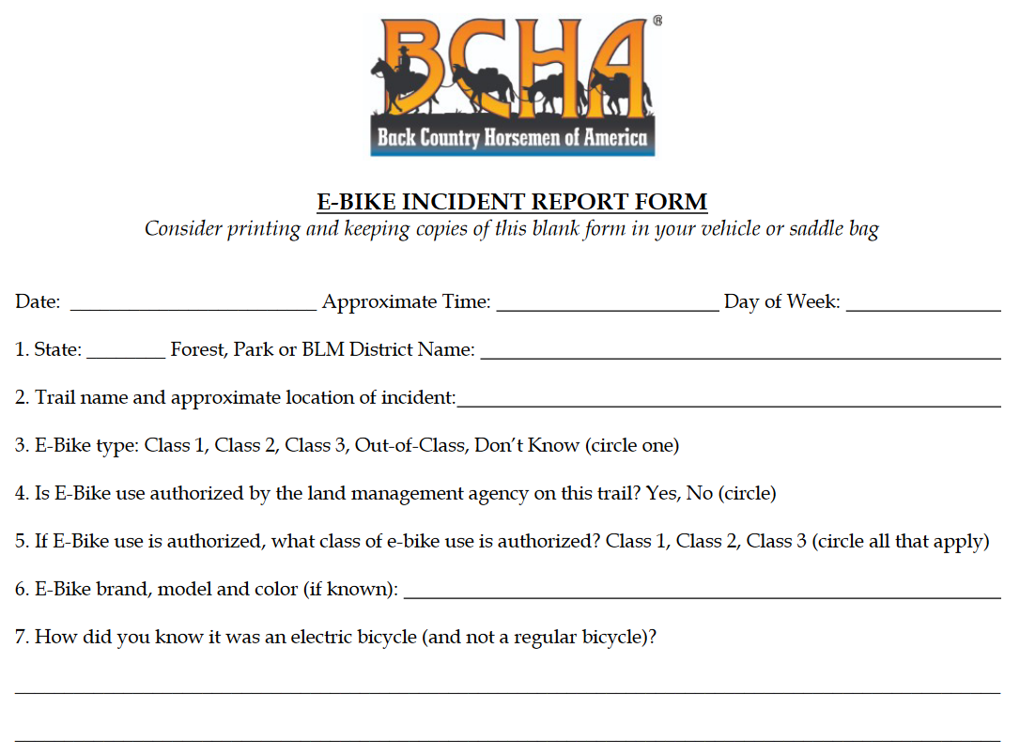

Slide 7
Director, Public Lands & Recreation
National Policy
National Partnerships
WildernessAdvisor@bcha.org

Slide 8
Defending Against Electric Bikes

Slide 9
Electric motorized bicycle (e-bike)
REI advertisement

Slide 10
Battery, motor & extra battery

Slide 11
E-bike: You can barely see the battery

Slide 12
Not All e-Bikes the Same
Commuter Hybrid (250W peak)
eMTB (1800W peak output)

Slide 13
What Might be Authorized on Trails Near You?

Slide 14
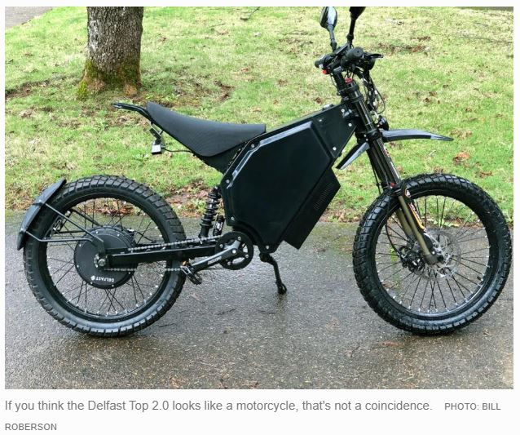
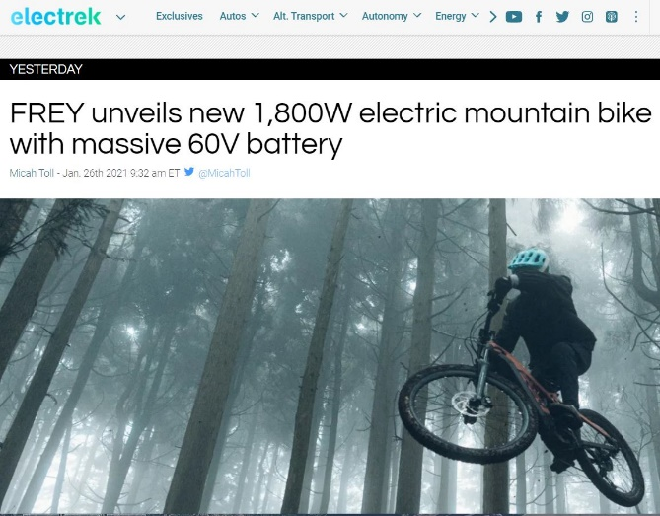
Out-of-Class: essentially electric motorcycles with pedals

Slide 15
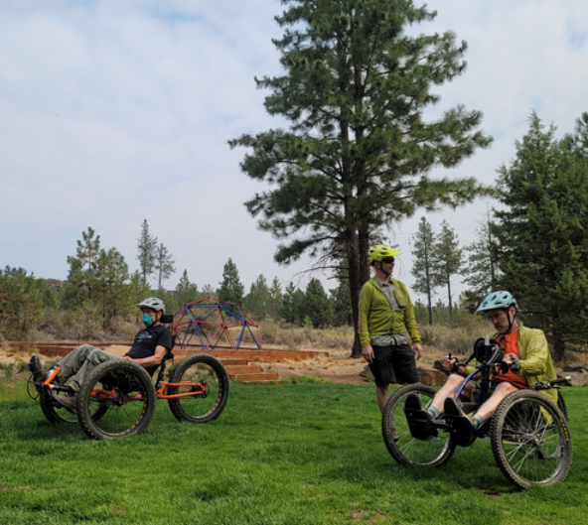
Benefits of e-bikes
Reduces one’s reliance on automobiles for short trips, etc. (and thus reduces harmful air emissions).
Encourages fitness and facilitates public enjoyment of the outdoors.
May provide new opportunities for individuals who might otherwise be prevented from experiencing the great outdoors without an e-bike’s motor-assist.
Adaptive Mountain Bike (aMTB)

Slide 16
Department of Interior
Aug. 29, 2019
Key Take-a-Ways:
All DOI agencies to adopt three-class e-bike system.
“E-bikes shall be allowed where other types of bicycles are allowed;” and
“E-bikes shall not be allowed where other types of bicycles are prohibited.”

Slide 17
National Park Service
Park superintendents can declare, via updates to the “Superintendent’s Compendium,” that e-bikes and eMTBs are authorized on trails where mountain biking is already allowed.
Process does not require public input, but superintendents would be wise to do so.
List of national park units that have a substantial amount of backcountry mountain bikes trails includes.
Everglades, Lassen Volcanic and Mammoth Cave national parks,
Big South Fork National River and Recreation Area, and
Golden Gate, Santa Monica Mountains, and Whiskeytown national recreation areas (NRAs).

Slide 18
Golden Gate NRA: No public review

Slide 19
U.S. Forest Service (not a DOI agency)
2022 E-Bike “Directives”
Key Take-a-Ways:
Updated FS Manual 7700 to adopt 3-class e-bike system.
Continues to manage e-bikes as motor vehicles per the 2005 Travel Management Rule (36 CFR 212, Subpart B).
Over 6,000 “unique” public comments submitted, with 33% supporting e-bike use and 58% opposed.

Slide 20
US Forest Service Public Service Announcement
“MOTORIZED BIKES ARE PROHIBITED ON NON-MOTORIZED TRAILS”
Unless…

Slide 21
The USFS (or the BLM)…
Seeks input from stakeholders
Conducts environmental analysis

Slide 22
Don’t assume that federal agencies can’t authorize e-bike use on non-motorized trails. They have and they will.
So BCHA continues to push the agencies to meet a very high bar...

Slide 23
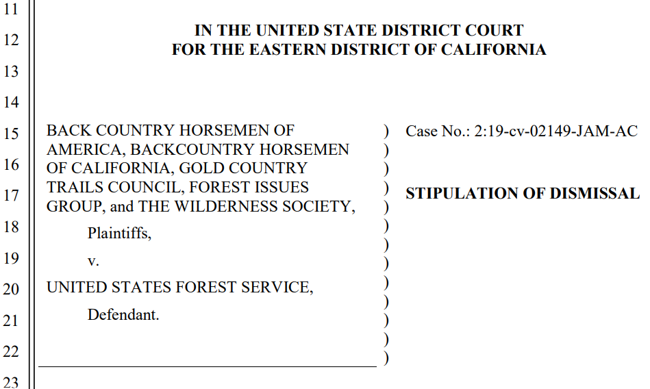
1. Through Litigation
BCHA engaged in litigation with the US Forest Service when the Tahoe National Forest announced in 2019 that it welcomed Class 1 e-bikes on over 130 miles of non-motorized trails.
The Forest Service quickly settled the lawsuit by agreeing to go back to Square 1 in their planning for e-bike use.

Slide 24
2. Insisting on Rigorous Analyses
Pointing out Deficiencies in the EA Analyses
Monitoring & Enforcement

Slide 25
We witnessed e-bike “wins” in: Arkansas (2023) Arizona (2022) New Mexico (2021)
Based on arguments regarding speed, safety, user conflict and recreational use “displacement.”

Slide 26
Are E-Bikes Faster than Regular Mountain Bikes?
Don’t believe it if someone claims that e-bikes don’t travel faster than regular bikes.
Look at scientific literature and what the e-bike industry itself is saying…
Real advertisement

Slide 27
“Increase Your Output by up to 410%”
“Specialized Turbo is not like anything you’ve ever experienced. It’s not even a bike! Its two wheels of hair-raising power that will revolutionize the way you move. It’s you, only faster. It’s distance being shorter. Up hills, easier. Downhills, crazier.”

Slide 28
E-bike speed a major concern of majority of hikers and equestrians
Source: Washington State DNR & Dept. of Fish & Wildlife, Sept. 2022

Slide 29
Enforcement challenges
Some e-bikes can be programmed to be either a Class 1, 2, 3 or “unlimited.”
Plenty of work-arounds to negate the motor’s governor.
YouTube includes dozens of tutorials on how to override the speed limiter on any e-bike.
“The advent of the e-bike lead to the advent of the e-bike hacker that would work tirelessly to overcome the governor to let em rip.” Oct. 18, 2022 online post, electrek.co

Slide 30
Some e-bike “hacks” on YouTube

Slide 31
Enforcement not the answer
The three different classes of e-bikes are hard to discern via the untrained eye.
E-bikes don’t carry large labels that declare what class; plus Class 3 e-bikes look more-or-less like Class 1 bikes and vice-versa.
BCHA contends that if an agency allows one class of e-bike use on non-motorized trails, they are in effect allowing all classes (plus out-of-class e-bikes), as law enforcement officers in the field essentially will be unable to enforce any restrictions on the type of e-bike allowed.

Slide 32
Enforcement not the answer (cont.)
USA Today, May 31, 2022
Paraphrased Jamie Hinrichs, spokesperson for Tahoe National Forest, who said:
He and just about everyone else in the controversy agreed that many rangers can’t even tell the difference between an electric bike and a regular one.
(The Forest Service) would be hard-pressed to say who's violating which rules.
Most trail overseers lack staffing to patrol backcountry trails, let alone appear in court over citations.
Photo: Southern Utah Wilderness Alliance
Article: “An electric bike rode into the backcountry. Now there’s a nationwide turf war”

Slide 33
Unacceptable Risk
The use of e-bikes on non-motorized trails and their potential for high speeds.
Coupled with their silent approach, e-bikes could create conflict between trail users and pose unacceptable risks to the safety of hikers, equestrians and others.

Slide 34
Steps to Take Before an E-Bike Proposal Threatens Trails Important to You
1. Engage in local trail coalitions (if they exist in your area)
Keep your ears open within the trails community about pending trail proposals and developments.
Follow blogs and websites of e-bike and mountain bike organizations.
2. Forge alliances with other trail groups, like hikers, bird watchers and others to expand your network.
American Hiking Society maintains a list of local allied hiking groups that can be searched by state https://americanhiking.org/hiking-resources/#hiking-alliance
Backcountry Hunters & Anglers shares many of BCHA’s concerns about e-bike use https://www.backcountryhunters.org/chapters
Learn whether local mountain bike groups oppose or support e-bike use
3. Call agency offices to ask that you be placed on their (email) mailing list for announcements about all recreation- and trails-related projects in locations of interest to your chapter.

Slide 35
Steps to Take Before an E-Bike Proposal Threatens Trails Important to You
4. Monitor the list of pending projects of local land management agencies.
The US Forest Service maintains a website https://www.fs.fed.us/sopa/ with quarterly updates for your national forest.
The BLM maintains a register of planning projects that allows you look up recreation projects by BLM state and district https://www.blm.gov/programs/planning-and-nepa/eplanning
5. Meet occasionally, have phone calls or zoom meetings, with agency trail managers
Discuss potential work projects and any specific concerns you have about e-bike use on non-motorized trails.
6. Encourage agency law enforcement to enforce the rules.
Volunteer to post “No e-bike” signs at non-motorized trailheads before e-bike trespass becomes a significant problem

Slide 36
Steps to Take Before an E-Bike Proposal Threatens Trails Important to You
7. Become proficient in spotting an e-bike (eMTB) on the trail.
Educate yourself at this website https://peopleforbikes.org/tag/e-bikes/ or do a simple search for photos and videos of e-bikes (and, importantly eMTBs) online.
Review this video by industry https://www.youtube.com/watch?v=GS2DoHw8k0o
8. Document cases of e-bike trespass or accidents on non-motorized trails
Document any accidents or unpleasant run-ins with people using e-bikes on non-motorized trails.
Share documentation with BCHA and agency law enforcement personnel. Such documentation may prove critical in making the case against shared-use trails with motorized e-bikes in the future.
9. Consider renting an e-bike from your local bike shop (either for a day or a few hours).
Understand how e-bikes operate, their benefits, limitations and noise they make.
Become a better advocate for protecting non-motorized trails by sharing your knowledge about the pros and cons associated with e-bike use.

Slide 37
Document, document, document
BCH Idaho
BCH New Mexico
Notes:
You can’t demonstrate to the land agency that a problem exists unless you have documentation.

Slide 38
Other Resources
BCHA Website
BCHA Webinar
Fall 2022 newsletter
Winter 2020/2021 newsletter
Summer 2020 newsletter
Fall 2019 newsletter
www.bcha.org/blog/category/alerts/
www.youtube.com/watch?v=60ItKbjd5bI

Slide 39
BLM Recreation Blueprint
americaslands.org

Slide 40
The BLM is the largest federal land agency. Yet it has the smallest budget.
245 million acres. That’s 1 out of every 10 acres of land in the U.S. across 30 states.

Slide 41
BLM Hugely Important in the West

Slide 42
BLM Recreation Blueprint

Slide 43
BLM Recreation Blueprint

Slide 44
Key Actions as Viewed by BCHA
Establish A BLM National Partnership Office.
Strengthen an Organization-Wide Commitment to Partnerships.
Engage Partners in Blueprint Implementation.
Use state-level recreation assessments and preliminary step-down plans under the Blueprint as a basis for further exploring and vetting priorities, partnerships, and resource needs.
Develop partnerships with state offices of outdoor recreation, and other partner and user groups, to convene state-level outdoor recreation summits that can further refine implementation strategies, share BLM and partner priorities, identify overlapping goals, and plan near-term, early action initiatives.

Slide 45
Key Actions (continued)
Strengthen the Bureau’s Outdoor Recreation Investment Proposition.
Clarify the need for and role of increased (congressional) appropriations in achieving the Bureau’s vision and effective implementation of the Blueprint.
Prioritize Near-Term Actions to Improve Access and Foster a Culture of Inclusion.
Identify state priorities and partnership opportunities for land and easement acquisitions to improve recreation access to BLM lands and waters.

Slide 46
American Horse Council

Slide 48
AHC Economic Report (cont.)

Slide 49
AHC Economic Report (cont.)

Slide 50
AHC Economic Report (cont.)

